Slide 1
Friend Mapper
Hamid Abdul Basit| Lahore School of Management Sciences

Slide 2
Team Introduction
Hassan Nawaz 2014-10-0085
Coding, Testing, Designing
Muhammad Ali Gulzar 2014-10-0017
Team Leader, Designing, Coding
Roshail Ahmed Tarar 2014-10-0183
Coding , Designing, Documentation
Syed Mutahir Hussan Kazmi 2014-10-0204
Coding, Designing, Testing

Slide 3
What makes our project special?
The idea of our application is completely original and pretty helpful for those who are in need of a friend.
Notes:
This is the question that your experiment answers

Slide 4
Project Overview
The Friend Mapper helps the user track his friends that he has added on his user account using the internet.
The friends of a user are shown as location tags on a map if they have enabled the sharing option.
The user himself is visible on the map. The map updates on regular time intervals set by the user.
The user can become invisible to his friends; this for our project is referred to as the “hide” functionality.
The user can contact his friends by message or phone call if needed.
Moreover, the user can turn on an alarm that tells him when he is in close proximity of his friend.
Also, an additional feature is that the user can track his phone in case of theft using an ID and PIN provided at the moment of registration.
There is a “Panic State” option which when pressed highlights particular users and sends messages to a specific chosen group of friends in case of emergencies. The changes in location are stored in a database that is on the server.

Slide 5
Developmental Process Model
Waterfall Model with feedback loops
The reason for using waterfall method was our project was documentation driven. The project was done in phases and this way the application will be easy to maintain.
Furthermore, whenever we encountered a problem we could easily change what we needed to in the previous phases which made implementation much easier for us. Ie in the planning phase we discovered that with out current number of use cases we would never be able to complete the project. Thus, we changed the requirements and decreased a few use cases.
Notes:
Summarize your research in three to five points.

Slide 6
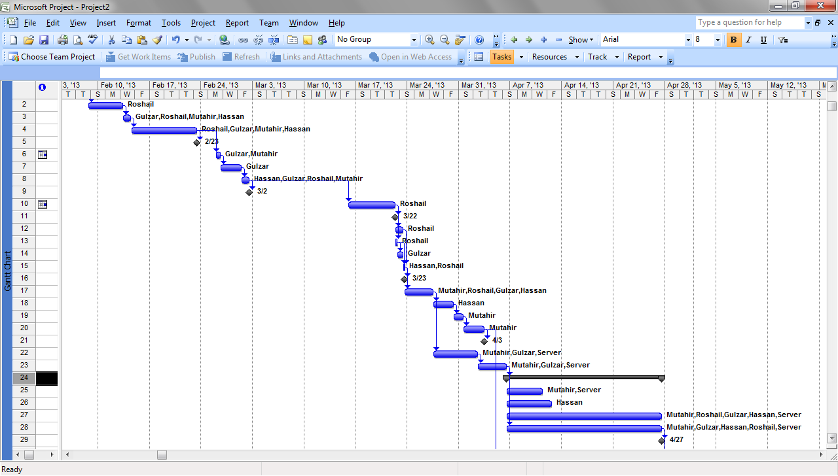
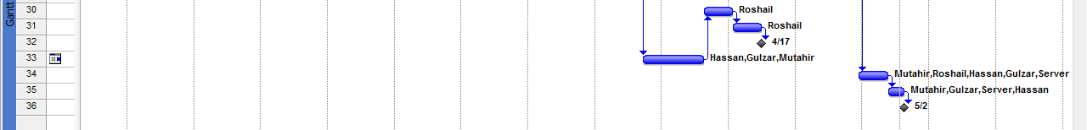
Project Activities Timeline

Slide 7
Tools and Technologies
Google Map
Eclipse IDE
Android Sdk
Microsoft Word
Microsoft Visio
Smart Draw 2012
Adobe Dream Weaver
Android Emulator
Cpanel
Microsoft Project
MySQL
PHP
HTML
Adobe Photoshop
Notes:
Summarize your research in three to five points.

Slide 8
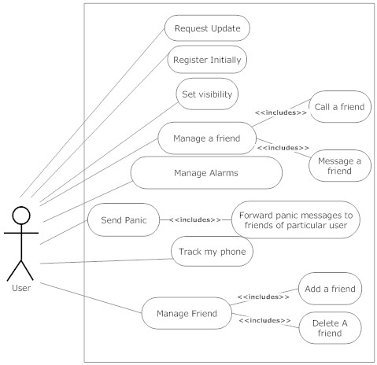
Use Case Diagram

Slide 9
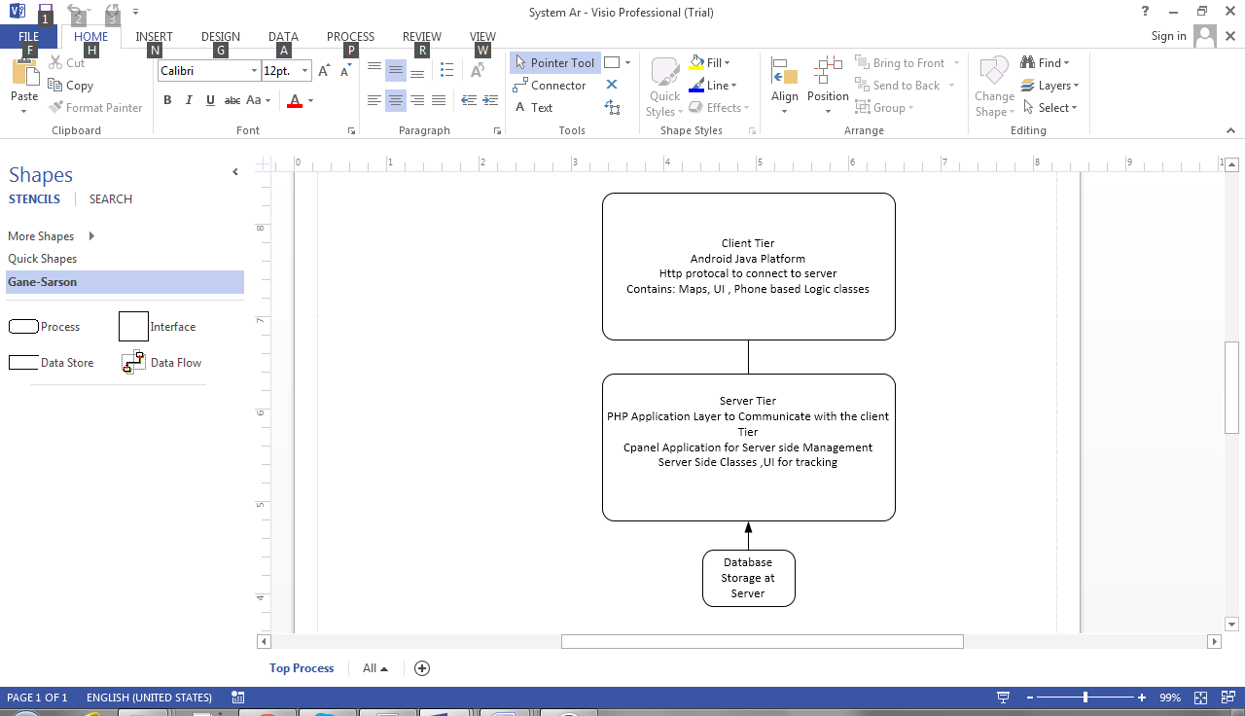
System Architecture

Slide 10
Domain Model
Members
ID,Name,Register,Pho No, Visibility , Location
FriendsRelation
UserID,FriendID
PanicAlert
UserID , FriendID
Request
UserID,FriendID , Status
Update
Friend,Location

Slide 11
Class Diagram

Slide 12
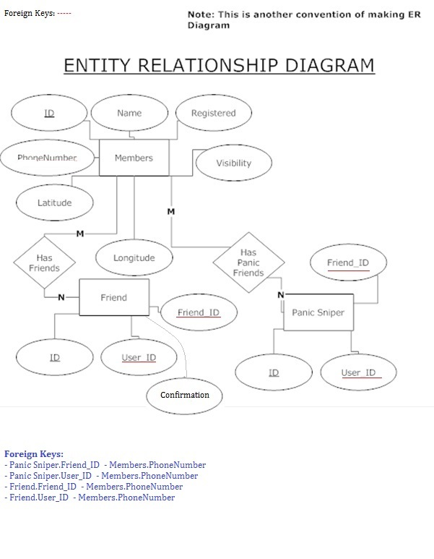
Database Schema

Slide 13
Project Demo
Our project is divided into 2 parts
The phone application will be shown by Hassan Nawaz
The website will be shown by Syed Mutahir Hussain Kazmi

